Slide 1

Game-Theoretic Scheduling in the Context of High-Level Synthesis
Gordan Konevski
8th Semester ELE
2022
Hochschule Hamm-Lippstadt 2022
Gordan Konevski

Slide 2
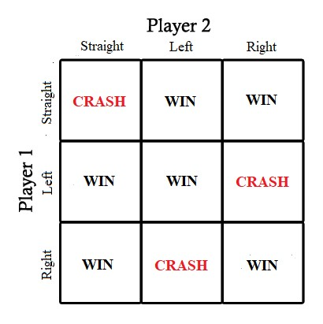
Game-Theory
Cooperative Game
Non-cooperative Game
Evolutionary Game Theory
Nash Equilibrium
Hochschule Hamm-Lippstadt 2022
Gordan Konevski

Slide 3
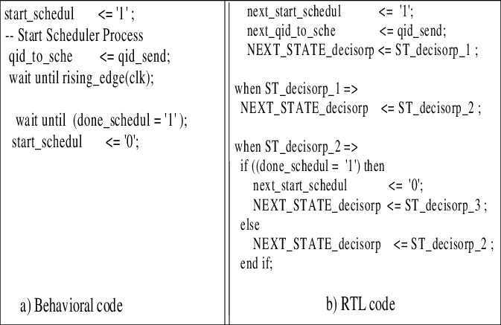
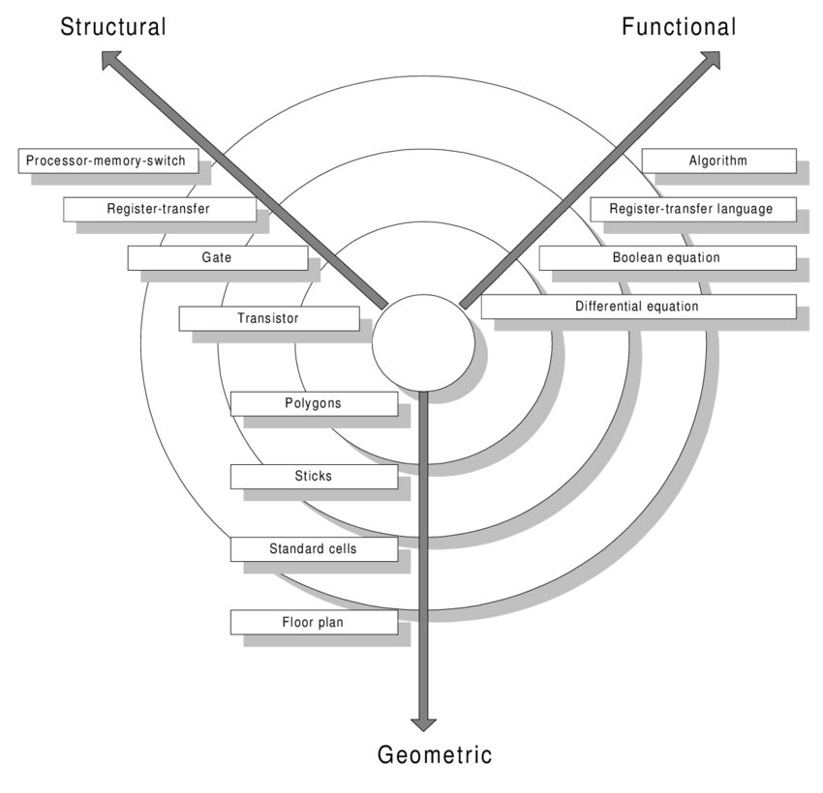
High-Level (Behavioral) Synthesis
Hochschule Hamm-Lippstadt 2022
Gordan Konevski
3

Slide 4
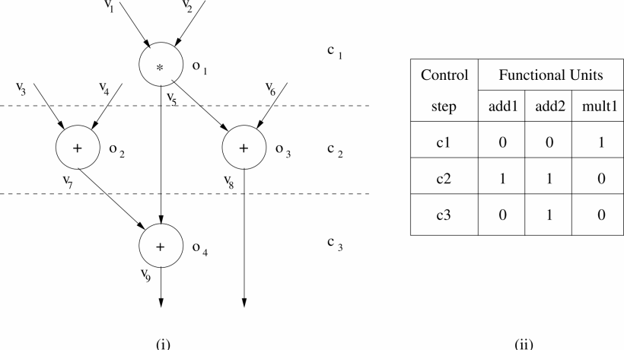


Binding in Behavioral Synthesis
Hochschule Hamm-Lippstadt 2022
Gordan Konevski
4

Slide 5
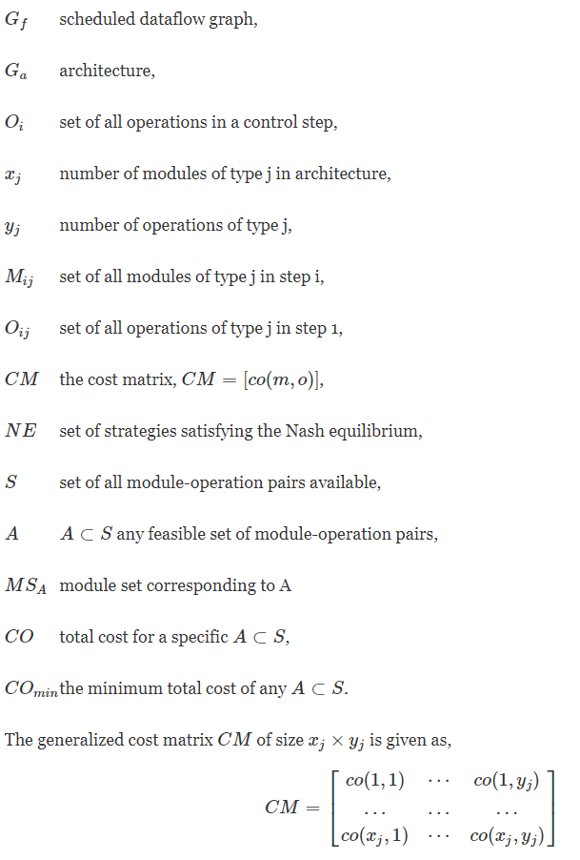
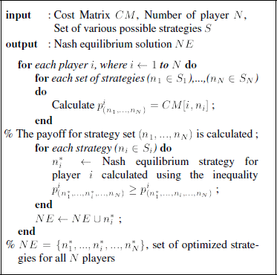
Hochschule Hamm-Lippstadt 2022
Gordan Konevski

Slide 6
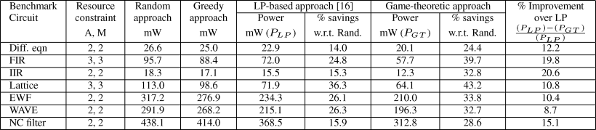
Non-Cooperative Approach Works Best
Hochschule Hamm-Lippstadt 2022
Gordan Konevski

Slide 7
Thank You for Your Attention
Hochschule Hamm-Lippstadt 2022
Gordan Konevski

Slide 8
Resources Used:
Reinforcement Learning and Decision Making in Monkeys During a Competitive Game - D. Lee, M.L. Conroy, B.P. McGreevy, and D.J. Barraclough
Mathematical Social Sciences - Branzei, R., D. Dimitrov, and S. Tijs
A Game-Theoretic Approach for Binding in Behavioral Synthesis - N. Ranganathan and Ashok K. Murugavel
Game Theory and its Applications (Static and Dynamic Games with Complete Information) - G. Abdoli
The Genetical Theory of Natural Selection - R. Fisher
Other material used:
https://commons.wikimedia.org/wiki/File:Collision_game.jpg
https://www.researchgate.net/publication/2306800/
https://www.researchgate.net/profile/Mario-Diaz-Nava/publication/3810046/

